Slide 1
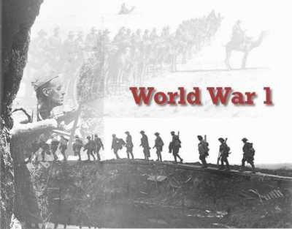
Introduction To

Slide 2
Causes of World War I
Neutrality was the original policy when the nations of Europe went to war with one another. (Nations would not interfere when two other nations went to war.
First Cause of WWI: Nationalism
This means devotion to ones country.
How could nationalism cause tension?
Competition and rivalry manifested and each country felt they were superior to the others.
Ethnic groups wanted autonomy and independence.

Slide 3
Causes of World War I
Second Cause: Imperialism
Controlling other areas/countries for the benefit of the mother/father country.
Natural resources were sent from controlled territories to the mother country to create products to make a profit.
Countries competed for land and resources in other places, this lead to conflict.

Slide 4
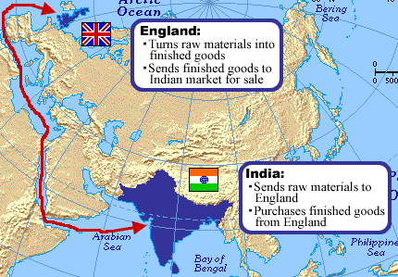
Imperialism in Action
Notes:
Explain to students how materials and finished products move between mother countries and controlled territories

Slide 5
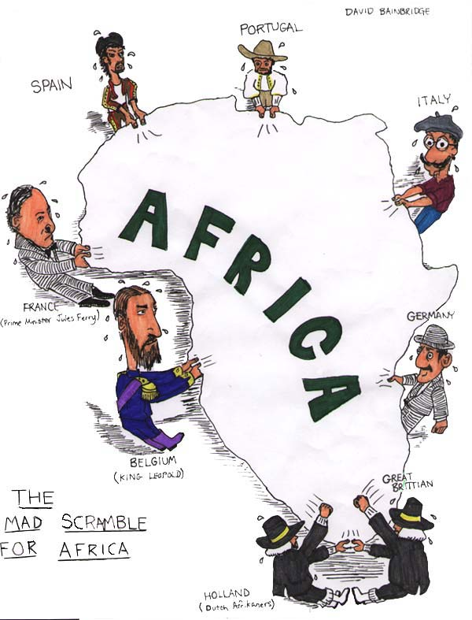
European powers competed for control of foreign territory in an effort to build up their Empires.
Notes:
Point out that each major country in Europe is in this picture fighting over land in Africa.

Slide 6
Causes of WWI Continued
Third Cause: Militarism
Each nation wanted to be the greatest on Earth.
1890: Germany was the mightiest nation on the mainland of Europe due to rapid industrialization.
1897: Keiser Wilhelm II expanded Germany to become a naval power. Who does this worry?
An “Arms race” focused on naval power began: France, Italy, Japan, and the USA joined this race.
Notes:
Who does this worry? Great Britain. Great Britain was the world’s greatest power at the time.
Arms Race: Rapid competition to gain weapons superiority over other nations

Slide 7
Causes of WWI Continued
Fourth Cause: Alliance Systems
1907: The Triple Entente Formed: Called the “Allies”: France, Britain, Russia.
Triple Alliance Formed: Germany, Austria-Hungary, Italy.
Eventually, they became the Central Powers: Germany, Austria, and the Ottoman Empire (Muslims).

Slide 8
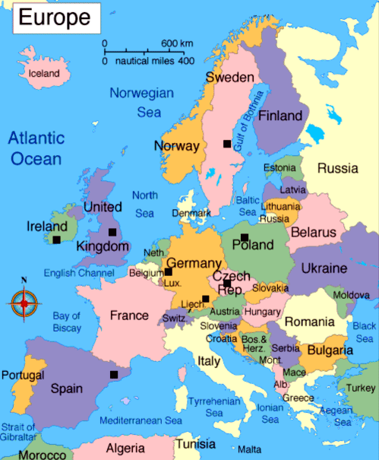
Notes:
Explain that this is Europe and Northern Africa, a large group of small countries. On the next slide, it will show how the Alliances of WWI played out.

Slide 9
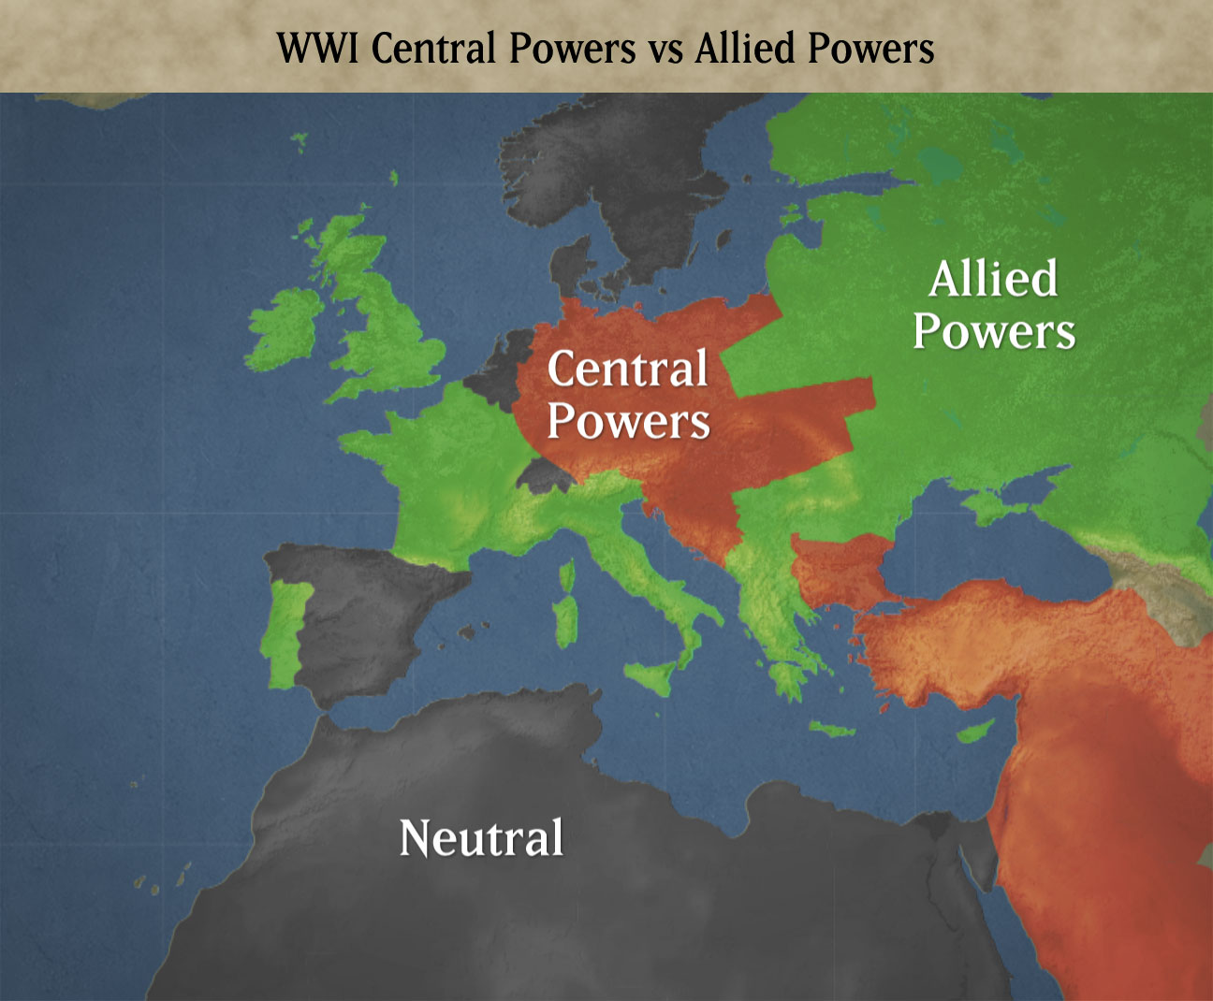

Slide 10
The Spark that Ignites the Fire of War
The Balkan Peninsula became a disputed area.
Russia and Austria wanted to control the Serbs.
The Balkans were the gateway to the Mediterranean Sea.
Germany wanted a railway to the Ottoman Empire (Modern Day Turkey).

Slide 11
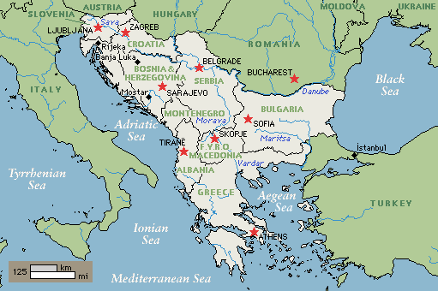
The Balkan Peninsula
Notes:
Point out Serbia

Slide 12
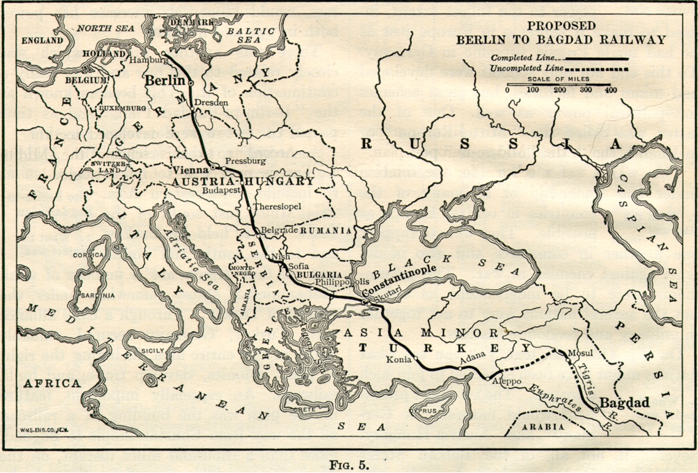
Germany Desired a Railroad to the Muslim World through Turkey

Slide 13
The Spark that Ignites the Fire of War
1914: Archduke Franz Ferdinand, heir to the Austrian throne, was assassinated by Gavrilo Princip, a Serbian nationalist.
Princip wanted independence for Serbia, not control from a foreign power like Austria.
Austria declared war against Serbia.
The Alliance system forced other nations to take sides: This spiraled out of control and lead to World War I.

Slide 14
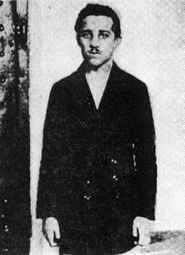
Gavrilo Princip: Assassinated Archduke Franz Ferdinand, heir to the Austrian throne. Sparked WWI.

Slide 15
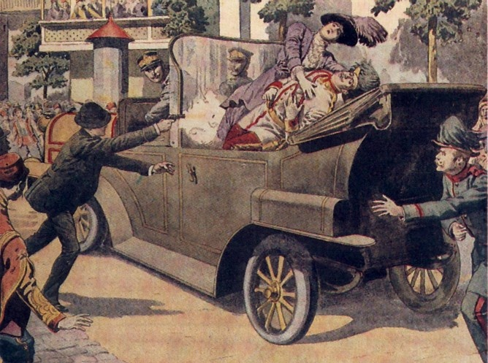
The Assassination of Archduke Franz Ferdinand
Notes:
Explain that Ferdinand was killed by a pistol shot in his car.

Slide 16
The Fighting Starts
8/1/14 Germany declared war on Russia. Why?
Russia came to defend Serbia from Austria.
Germany had an alliance system with Austria.
8/3/14 Germany declared war on France. Why?
They knew France would aid Russia.
8/3/14 Germany invaded Belgium. Britain declared war on Germany and Austria-Hungary.
World War I had begun.

Slide 17
Germany and her Enemies
Germany’s Schlieffen Plan: attack France first, then attack Russia.
September 1914: The Allies halted Germany at the Marne River: Each side dug trenches.
This new kind of fighting was called Trench Warfare.

Slide 18
Germany and her Enemies
“No man’s land” was the area between the trenches because it was so deadly.
“Going over the top” was a saying of the time that meant charging out of your trench.
Battle of the Somme- July 1, 1916: Britain lost 60,000 troops in a single day; 1.2 Million died in the end.

Slide 19
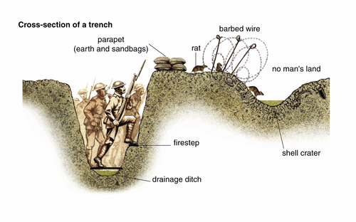

Slide 20
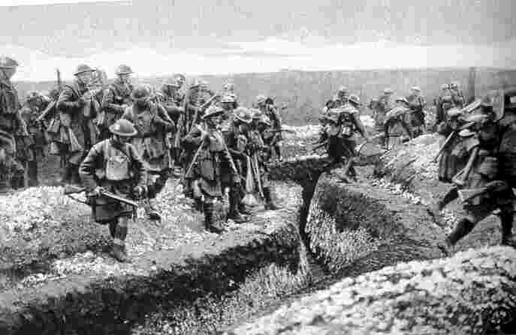

Slide 21
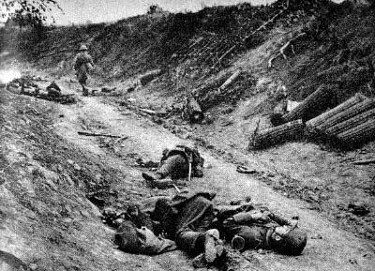

Slide 22
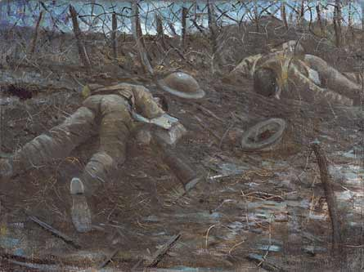

Slide 23
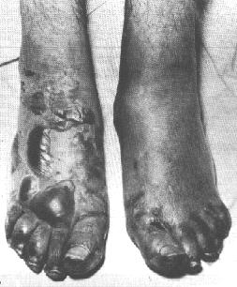
Trench Foot: A condition of the foot resembling frostbite, caused by prolonged exposure to cold and dampness and often affecting soldiers in trenches.

Slide 24
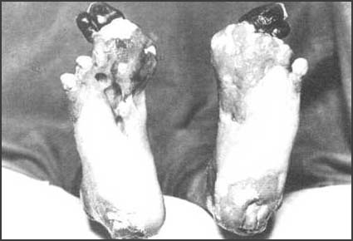

Slide 25
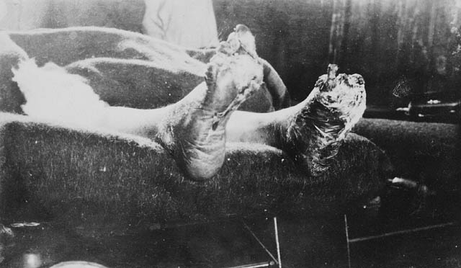

Slide 26
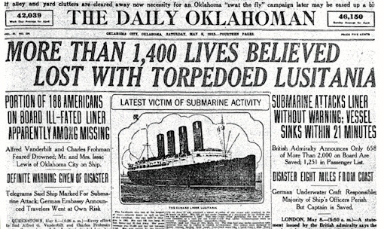
The conflict in Europe bogged down into a stalemate of horrific Trench Warfare.
Meanwhile the United States stood by and watched, maintaining a neutral position.
However, it wouldn’t be long until events pulled America into World War I.

